Slide 1

How to pack a PST tote bag
We require all of our totes to be packed according to our expected standards. This tutorial will show you how to do that.

Slide 2
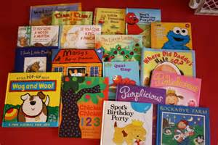
Sort collected items
Sort Books by age:
(1 - 4) - Preschool, picture books, short sentences.

Slide 3

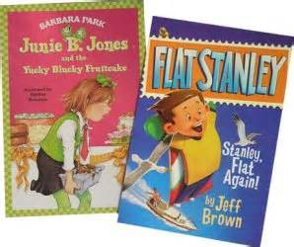
Sort Books by age:
(5 - 8) - Easy reading, small chapter books, multiple sentences.

Slide 4
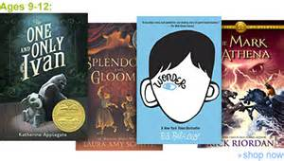




Sort books by age:
(9 - 12) - Chapter books, smaller print, resource books

Slide 5
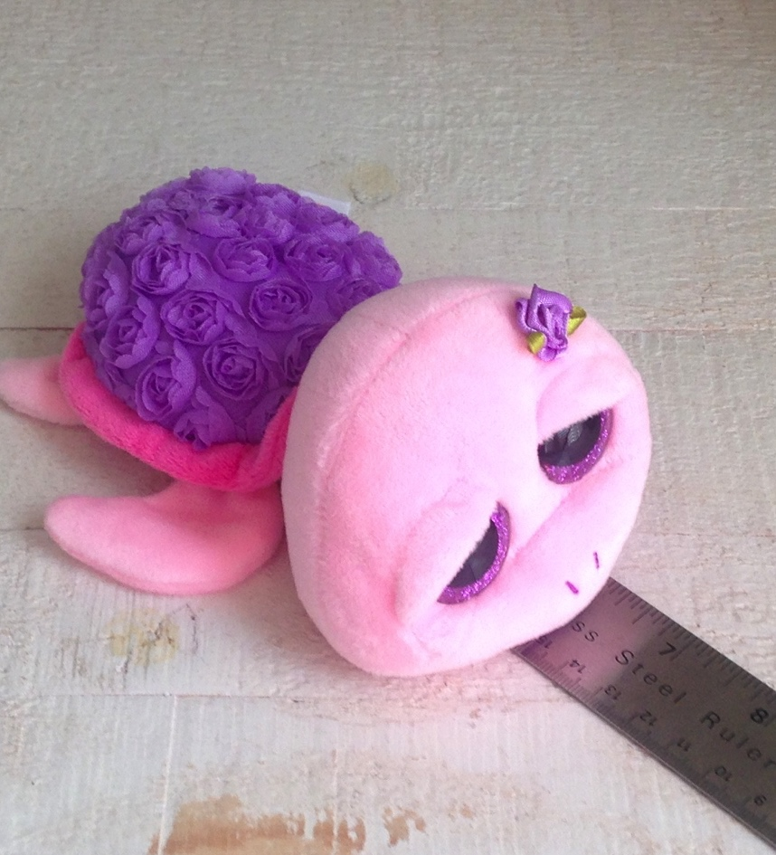
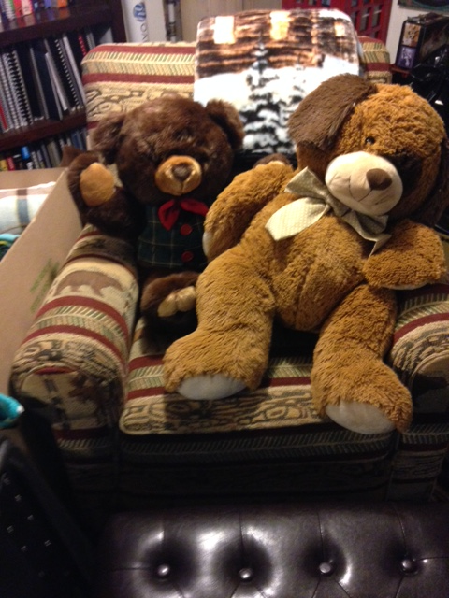
Sort stuffed animals
No batteries, beanie babies, or dolls
Minimum size 7 inches to Maximum size 15 inches
X
X

Slide 6
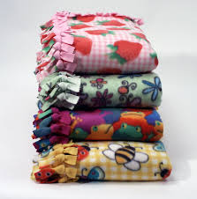
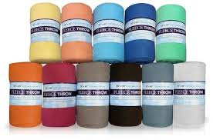
Sort and roll blankets
Fleece blankets-ideal size 45” to 60”
New or can be hand-tied. Single layer only.

Slide 7
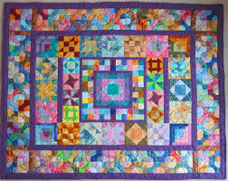
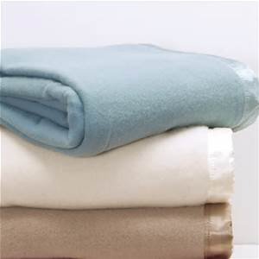
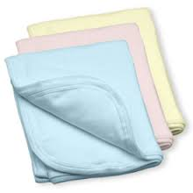
Blankets we do not accept
Quilts – too bulky
Bedding – too big/bulky
Receiving blankets – too small
Afghans or knitted
Double layered.
Unfinished edges.

Slide 8
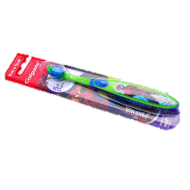
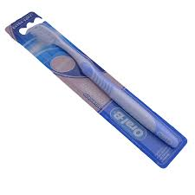


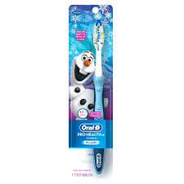
Toothbrushes
Individually wrapped: youth and adult sized
DO NOT use multi-packs: they need to be individually wrapped for hygienic purposes.

Slide 9
Filling the tote:
Roll blanket up like a log, insert into tote bag.
Place appropriate sized stuffed animal next to blanket (head up).
Select a book (may pack 2 if extra books are collected).
Add a toothbrush.
Be sure the book selected matches the age of the child the tote is intended for.
Youth toothbrushes are for ages 1 – 4 and 5 – 8.
Adult toothbrushes are for ages 9 – 12.
Finally add a bag tag to the front handle.

Slide 10
-DO NOT-
Add extra items: toys, dolls, candy, crayons, coloring books, clothing, notes,etc.

Slide 11
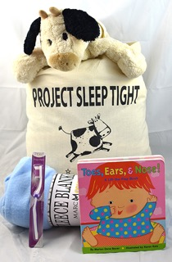
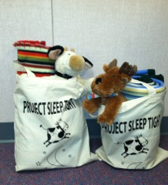
Finished tote

